Slide 1
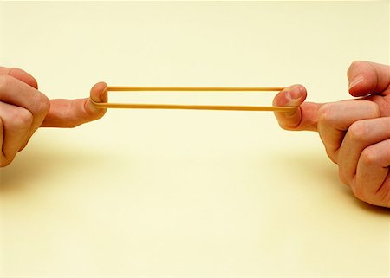
Unit 5 Chapter 5
ELASTICITY
AND ITS APPLICATION

Slide 2
CONCEPT OF ELASTICITY
Law of demand: when the price of a good rises, the quantity demanded falls
BY HOW MUCH?
Elasticity as a measure of degree of responsiveness of quantity demanded or quantity supplied to a change in one of its determinants
ELASTICITY
OF DEMAND
OF SUPPLY
Price elasticity of demand
Income elasticity of demand
Cross-price elasticity
Price elasticity of supply
How much the quantity demanded responds to a change in price
Elastic and inelastic demand

Slide 3
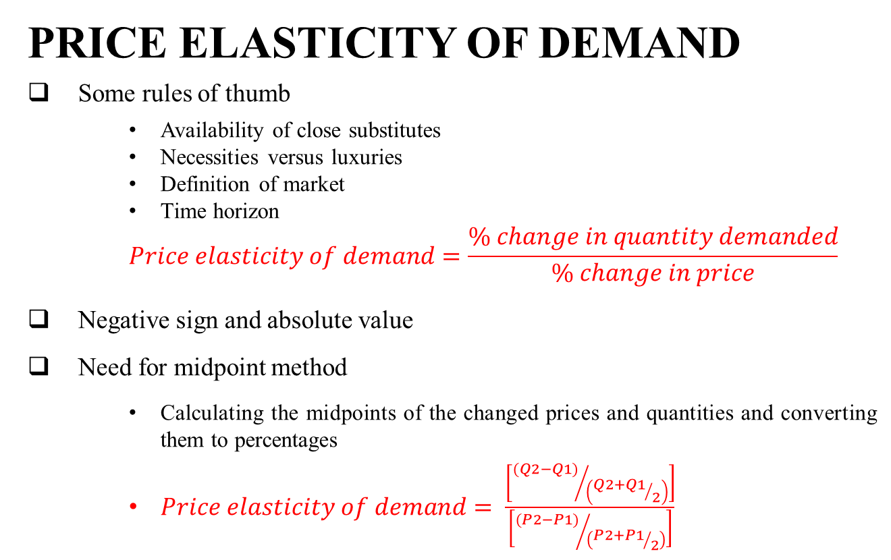
PRICE ELASTICITY OF DEMAND
Some rules of thumb
Availability of close substitutes
Necessities versus luxuries
Definition of market
Time horizon
$$Price elasticity of demand=\frac{\% change in quantity demanded}{\% change in price}$$
Negative sign and absolute value
Need for midpoint method
Calculating the midpoints of the changed prices and quantities and converting them to percentages
$Price elasticity of demand= \frac{\left[{(Q2−Q1)}/{\left({Q2+Q1}/2\right)}\right]}{\left[{(P2−P1)}/{\left({P2+P1}/2\right)}\right]}$
Five varieties of price elasticity of demand
Other elasticities of demand

Slide 4
ELASTICITY AND TOTAL REVENUE
Total revenue: the amount paid by buyers and received by sellers of a good, computed as the price of the good times the quantity sold
Changes in total revenue along the demand curve depends on the elasticity of the demand curve
If the demand is inelastic; the total revenue will increase at a higher price
If the demand is elastic; total revenue will decline at a higher price
If the demand curve is unit elastic; there will be no change in the total revenue at a higher price
Elasticity and total revenue along a linear demand curve

Slide 5
ELASTICITY OF SUPPLY
Law of supply: when the price of a good rises, the quantity demanded also rises
The price elasticity of supply measures how much the quantity supplied responds to changes in the price
Elastic and inelastic supply
Inelastic in the short-run and elastic in the long run
Five varieties of supply elasticities
Varying elasticities of supply along the same curve

